Slide 1

OSU Data Analysis Bootcamp

Slide 2

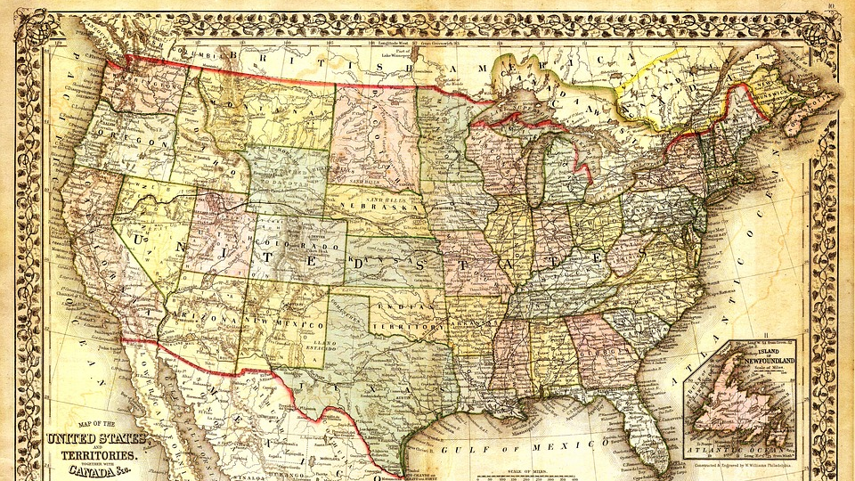
Wages by Education in USA
1973-2022

Slide 3
PRESENTED BY:
APRIL JOHNSON
RANDY SILVEY
RENEE PLEASNICK

Slide 4

Questions
Are female earnings trending towards as much as males with an Advanced degree?
Does the increase in Education affect the increase in salary for both men and women equally?
In the last 5 years for those with an Advanced Degree is there a difference between the groups based on race?

Slide 5
Are female earnings trending towards as much as males with an Advanced degree?
Question 1

Slide 6
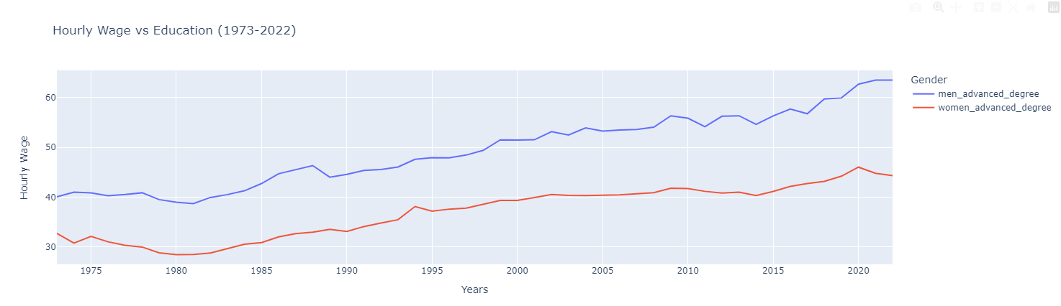
There is a distinct gap throughout the years between the wages of men vs women with an advanced degree.

Slide 7
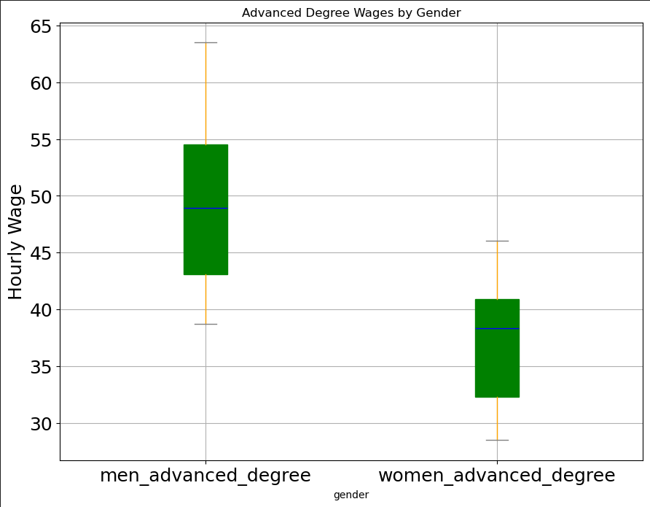
Over the last 50 years, data shows that men earn more than women with an advanced degree
Anova: pvalue = 1.57e-16 shows statistical difference between wages
Ttest: pvalue = 4.18e-16 show statistical difference between Men with an Advanced Degree and Women with an Advanced Degree

Slide 8
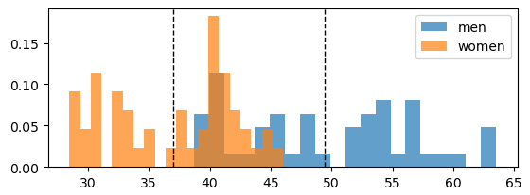
The mean for women is roughly 37 while for men is 49.

Slide 9
Does the increase in education affect the increase in hourly wage for both men and women equally?
Question 2

Slide 10
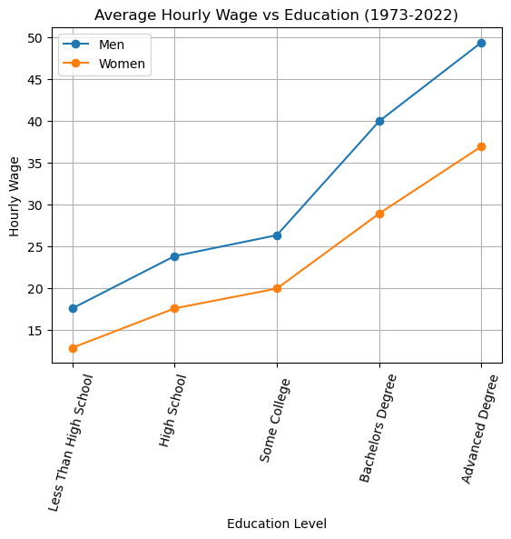
As the education level increases, the hourly wage increases at a similar rate for men and women.

Slide 11
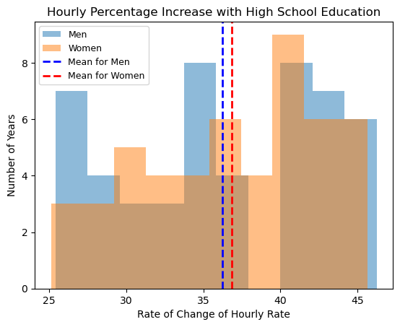
Men and women see a similar rate of increase with a high school diploma (1973 -2022) The p-value = 0.621 Shows no significant difference

Slide 12
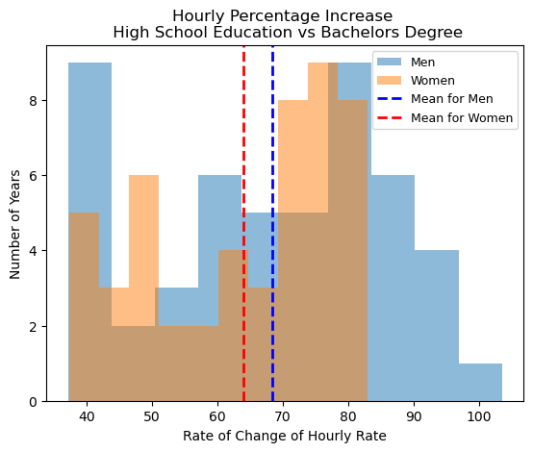
Men and women see a similar rate of increase with a Bachelor Degree (1973 -2022). The p-value = 0.199 Shows no significant difference

Slide 13
In the last 5 years, for those with an Advanced Degree, is there a difference between the groups based on race?
Question 3

Slide 14
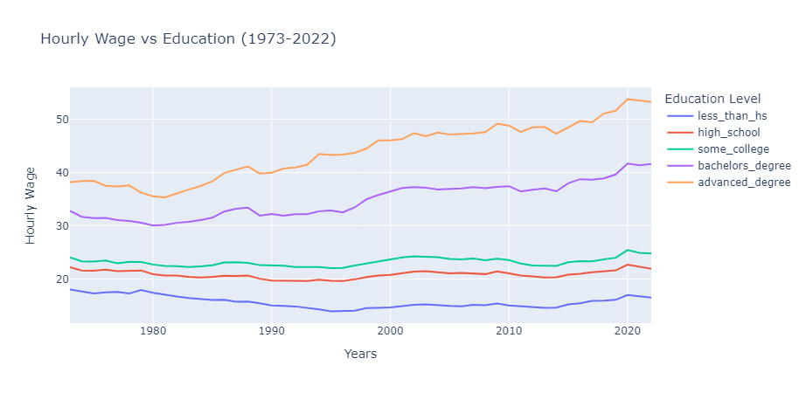
Throughout the Years an Advanced Education has always correlated with an increase in Wages

Slide 15
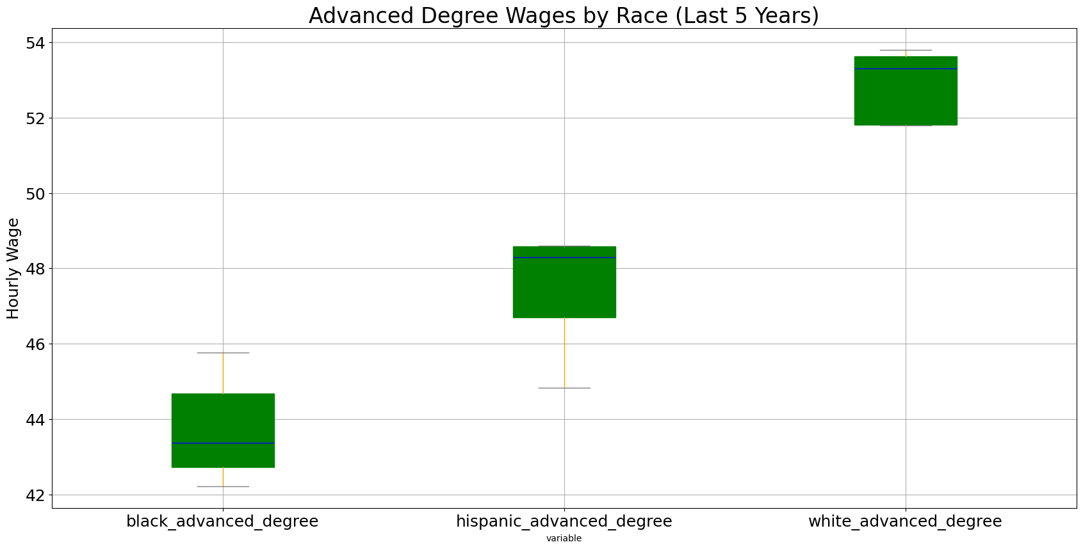
Last 5 years shows the discrepancies of wages between the races
Anova: pvalue = 9.22e-07 shows statistically difference between the wages
Ttest: pvalue = 0.0059 show statistically difference between Black Advanced Degree and Hispanic Advanced Degree

Slide 16
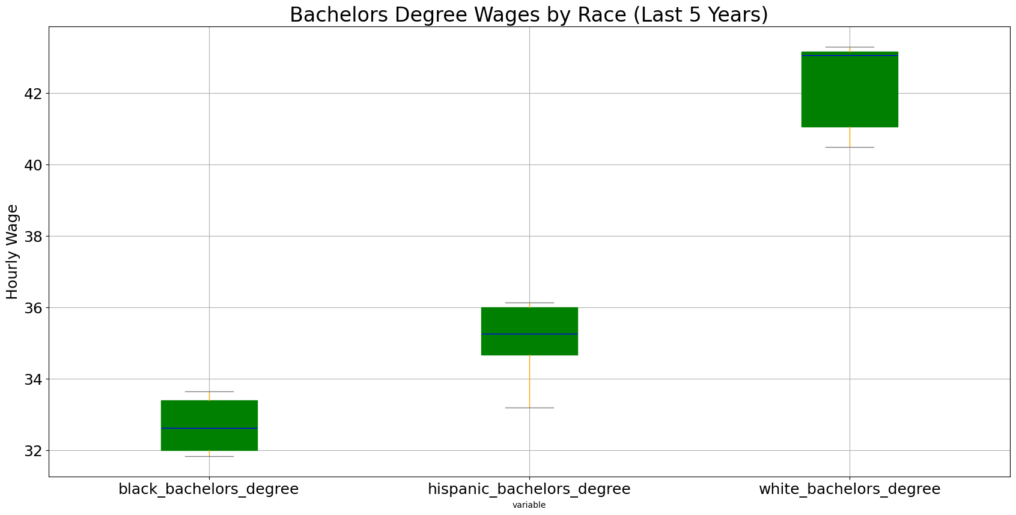
Last 5 years shows the discrepancies of wages between the races
Anova: pvalue = 4.24e-08 shows statistically difference between the wages
Ttest: pvalue = 0.0082 show statistically difference between Black Bachelors Degree and Hispanic Bachelors Degree

Slide 17
Questions

